Slide 1
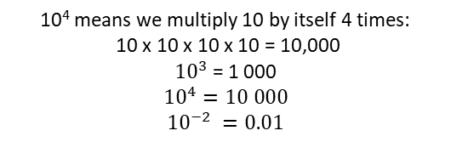

Subtopic N1.19 – Investigate Negative Powers of 10
LEARNING OUTCOME: To gain an understanding of negative powers of 10
Objectives:
Keywords:
Indices
Power
Standard Form
To understand what negative powers of 10 mean
To multiply by negative powers
To turn numbers less than 0 into standard form
Introduction – Read and annotate:
Standard form with negative powers of 10 is used to represent very small numbers in a clear and
efficient way. In this format, a × 10ⁿ, a is a number between 1 and 10, and n is a negative integer that
shows how many times we divide by 10. This extends our understanding of place value and powers
of 10, helping us work confidently with decimals and very small values in both maths and science.
Characteristics
Definition
Base: The base is the number you're multiplying by itself. Index: The index tells you how many times to multiply the base by itself. Power: The base and the index together (10³ is the power).
Powers are a way of showing that a number is multiplied by itself several times. It's like a shortcut for writing repeated multiplication. We use small numbers, called indices, to show how many times the number is multiplied by itself.
10 is the base
3 is the index
Examples
Powers
Non - Examples
Investigating negative numbers through pattern spotting
Example 1 - I do…
Example 2 – We do…
Example 3 – You do…
Steps | Complete the following: | Complete the following: | Complete the following:
1) Start with the positive powers. How many times has 10 been multiplied by itself? Multiply the base by this amount.
2000
5300
3100
200
530
310
20
53
31
2
5.3
3.1
0.2
0.53
0.31
0.02
0.053
0.031
Name | Decimal Notation | Index notation | Power
One | 1 |  | 0
One tenth | 0.1 |  | -1
One hundredth | 0.01 |  | -2
One thousandth | 0.001 |  | -3
One millionth | 0.000 001 |  | -6
One billionth | 0.000 000 001 |  | -9

Slide 2
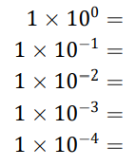
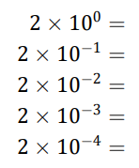
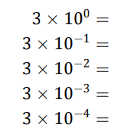
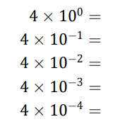
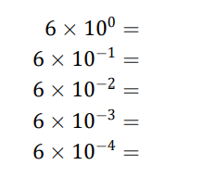
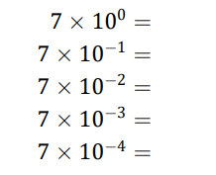
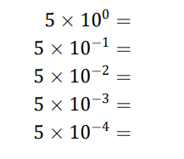
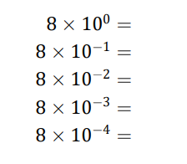
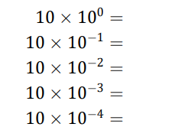
Example 4 - I do…
Example 5 – We do…
Example 6 – You do…
Complete the following: | Complete the following: | Complete the following:
1 x 1 = 1
1 x 0.1 = 0.1
1 x 0.01 = 0.01
1 x 0.001 = 0.001
1 x 0.0001 = 0.0001
2 x 1 = 2
2 x 0.1 = 0.2
2 x 0.01 = 0.02
2 x 0.001 = 0.002
2 x 0.0001 = 0.0002
3 x 1 = 3
3 x 0.1 = 0.3
3 x 0.01 = 0.03
3 x 0.001 = 0.003
3 x 0.0001 = 0.0003
Independent Practice
Question 1. Complete the following:
a) | b) | c)
d) | e) | f)
4 x 1 = 4
4 x 0.1 = 0.4
4 x 0.01 = 0.04
4 x 0.001 = 0.004
4 x 0.0001 = 0.0004
6 x 1 = 6
6 x 0.1 = 0.6
6 x 0.01 = 0.06
6 x 0.001 = 0.006
6 x 0.0001 = 0.0006
7 x 1 = 7
7 x 0.1 = 0.7
7 x 0.01 = 0.07
7 x 0.001 = 0.007
7 x 0.0001 = 0.0007
5 x 1 = 5
5 x 0.1 = 0.5
5 x 0.01 = 0.05
5 x 0.001 = 0.005
5 x 0.0001 = 0.0005
8 x 1 = 8
8 x 0.1 = 0.8
8 x 0.01 = 0.08
8 x 0.001 = 0.008
8 x 0.0001 = 0.0008
10 x 1 = 10
10 x 0.1 = 1
10 x 0.01 = 0.1
10 x 0.001 = 0.01
10 x 0.0001 = 0.001
Converting standard form with negative powers to ordinary numbers
Example 7 - I do…
Example 8 – We do…
Example 9 – You do…
Steps | Write as an ordinary number: | Write as an ordinary number: | Write as an ordinary number:
1) Multiply the decimal number by the negative power of 10
0.09441
0.016
0.0049

Slide 3
Independent Practice
Question 2. Write the following in ordinary form:
0.007568
0.098914
0.08397
0.065661
0.023
0.043
0.0087
0.0047876
0.007847
0.00761
0.72
0.359
0.226
0.06899
Question 3.
Tom and Katie are discussing standard form.
Tom says 8 x 10⁻³ < 8 x 10⁻² Katie says 8 x 10⁻³ < 9 x 10⁻³
Who is correct?
A. Only Tom B. Only Katie C. Both Tom and Katie D. Neither of them
Question 4.
Tom and Katie are discussing standard form.
Tom says 7 x 10⁻⁴ > 6 x 10⁻⁵ Katie says 7 x 10⁻⁴ > 6.59 x 10⁻⁴
Who is correct?
A. Only Tom B. Only Katie C. Both Tom and Katie D. Neither of them
Question 5.
Put these numbers in order from smallest to biggest
82 x 10³ 8 x 10⁻⁴ 8.1 x 10² 803
8 x 10⁻⁴ , 803, 8.1 x 10², 82 x 10³

Slide 4















Writing numbers in standard form
Example 7 - I do…
Example 8 – We do…
Example 9 – You do…
Steps | Write in standard form: | Write in standard form: | Write in standard form:
1) What will the first number be? 2) What power of 10 does it need to be multiplied by to keep it equal?
Independent Practice
Question 6. Write the following in standard form:
7. Complete the tables:
Ordinary Number | Standard Form
0.000901
Ordinary Number | Standard Form
0.0015

Slide 5


























8. Write these numbers in standard form:
a) Five tenths | b) Three hundredths
c) Four thousandths | d) Twelve hundredths
e) Eighteen hundredths | f) Thirty-three thousandths
9. Write these numbers in standard form:
Skills Check
Write seven thousandths in standard form.

